Slide 1
Practical Session 1

Slide 2
Aim of the practical assignment
Simulate a nucleotide sequence of length 10000 nucleotides so it has in probability:
10% of A
40% of G
30% of T
20% of G

Slide 3
Aim of the practical assignment
To report
Python code PROPERLY COMMENTED LINE BY LINE (i.e. before the line starts, say what is the next command going to do)
More than 20% of uncommented code = 0 points
Features to be evaluated
Code readability
Code performance
Elegance of solution (usage of functions and classes)

Slide 4
Random multinomial generator
From the Art of War: “If you know the enemy and know yourself, you need not fear the result of a hundred battles. If you know yourself but not the enemy, for every victory gained you will also suffer a defeat. If you know neither the enemy nor yourself, you will succumb in every battle.”
What do we need to generate a random sample with the expected nucleotide proportions?

Slide 5
Random multinomial generator
From Vose (article you have to read!)
In Python
import random
# integer sampled from uniform between 0 and 100
print(random.randint(0,100-1))
# double sampled from uniform between 0 and 1
print(random.uniform(0,1))

Slide 6
Random multinomial generator
From Vose (article you have to read!)
In Python
#Use lists to classify the indexes of p in large and small
large = [];
small = [];
# Identify n
n = len(p)
# iterate over the n elements
for j in range(n):
# decide to assign j to large or small
if x > y:
# use append()
else
# use append()

Slide 7
Random multinomial generator
From Vose (article you have to read!)
In Python
l = len(large)
s = len(small)
prob_j = [None]*n
alias_j = [None]*n

Slide 8
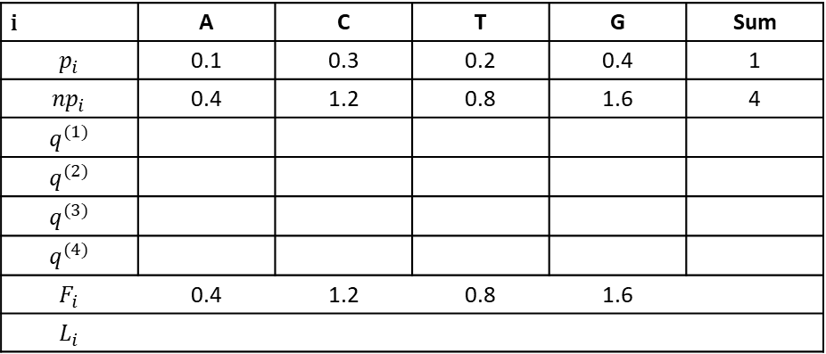
Random multinomial generator
Alias Vose
Classical Alias
i | A | C | T | G | Sum
$$p_{i}$$ | 0.1 | 0.3 | 0.2 | 0.4 | 1
$${np}_{i}$$ | 0.4 | 1.2 | 0.8 | 1.6 | 4
$$q^{(1)}$$
$$q^{(2)}$$ | Esa
$$q^{(3)}$$
$$q^{(4)}$$
$$F_{i}$$ | 0.4 | 1.2 | 0.8 | 1.6
$$L_{i}$$
$$I_{i}$$ | -1 | 1 | -1 | 1

Slide 9
Random multinomial generator
Alias Vose

Slide 10
Random multinomial generator
Python. Work with classes and functions!
import random
class RandomMultinomial(object):
'''
Constructor
'''
def __init__(self, p):
self.p = p
self.n = len(self.p)
self.alias = [None] * self.n
self.prob_j = [None]* self.n
self.build_alias()
'''
Create the alias for p
'''
def build_alias(self):
large = []
small = []
for j in range(self.n):

Slide 11
Random multinomial generator
Python. Work with classes and functions!
def main():
p = [0.1,0.2,0.2,0.5]
alias = RandomMultinomial(p)
count = [0]*len(p)
for i in range(100000):
j = alias.sample()
count[j] = count[j] + 1.0/100000.0
print(count)
if __name__ == "__main__":
main ()

